Slide 1
MY JOURNEY
QuantHub
Data Scholar

Slide 2
ABOUT ME
Locust Fork High School
University of Alabama in Huntsville
Cori Barwick
— Business Analyst —
— Business Owner —

Slide 3
My Internship
Economic Development Partnership of Alabama
PROJECTS
Mentors
WORKED
TOTAL PROJECTS
7
WHAT KIND OF PROJECTS?
ChatGPT
Power BI
Data Cleaning
Jacob Lamb
&
Lauren Hyde
MONDAY
TUESDAY THURSDAY
9:00 am - 4:00 pm
21 Hrs/week

Slide 4
P
R
O
J
E
C
T
ChatGPT
EARNING CALL SUMMARIES
GOAL
Create a GPT to summarize earnings calls and output the summaries in a proper format.
1
Objectives Complete
Increased efficiency of Earning call reviews.
Created and Instructed a OpenAI GPT.
Trained an AI then tested an AI model on unseen data.
Skills
ChatGPT
Prompt Engineering

Slide 5
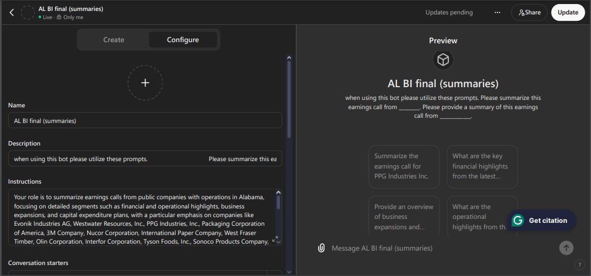
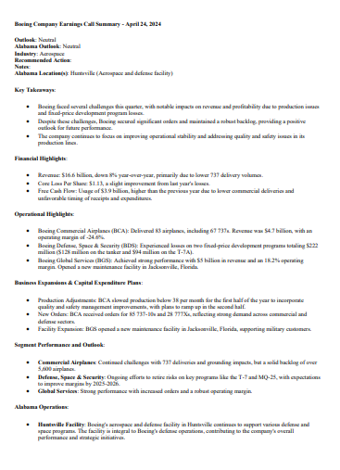
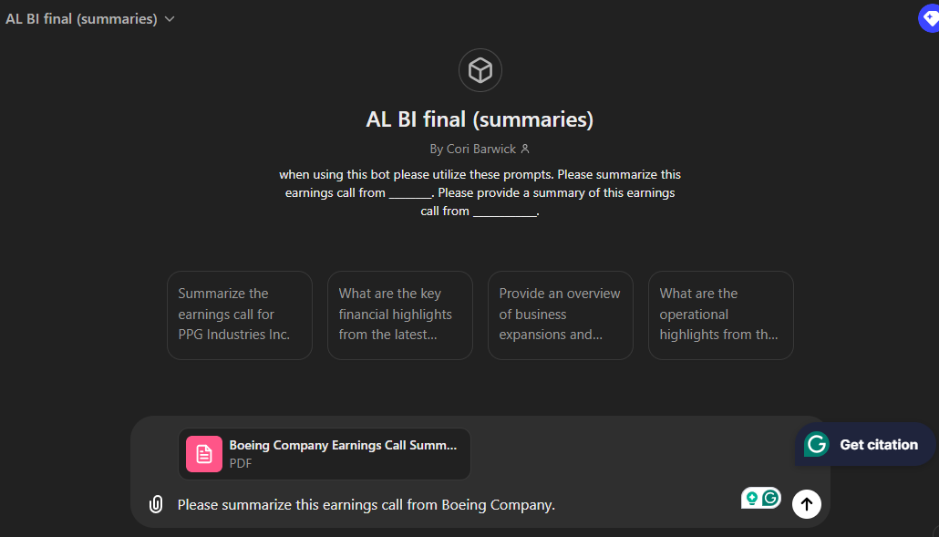

Slide 6
P
R
O
J
E
C
T
SBIR STTR POWER BI
GOAL
Create a Power BI Dashboard to visualize the SBIR STTR Grant dataset.
6
Skills
Power BI
Dashboards
Data Visualization
Objectives Complete
Provided better visualization of a large database.
Created a multi page dashboard to view a variety of data types
Added user friendly ways to navigate the dashboard.

Slide 7
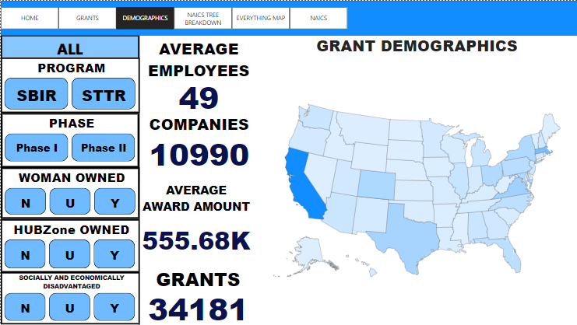
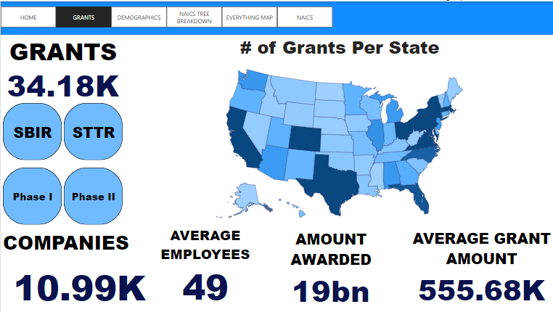
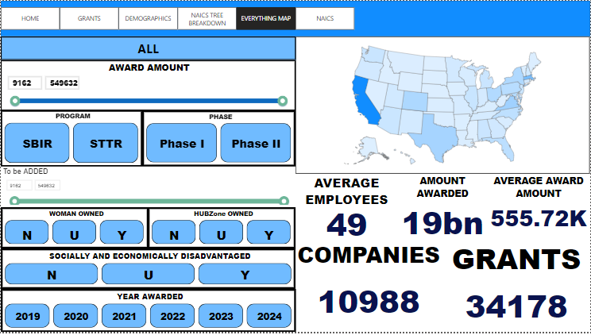

Slide 8
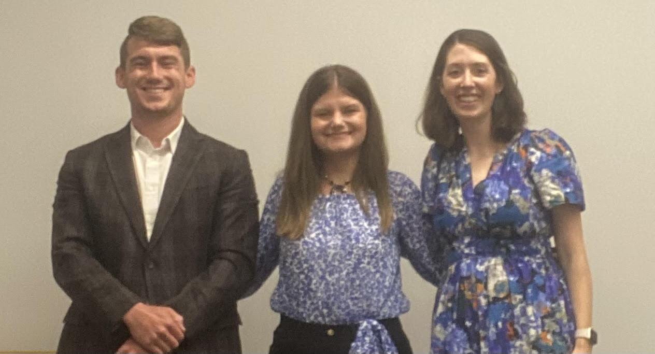
THANK YOU
JACOB LAMB
MENTOR LAUREN HYDE
MENTOR
KELSEY BICKETT
QUANTHUB COORDINATOR
SHANNON ALLEN
INTRODUCED ME TO QUANTHUB PROGRAM
EDPA STAFF & QUANTHUB STAFF

