Slide 1
My internship with Talent Engines
Alabama Data Scholars Program
Adam Battraw

Slide 2
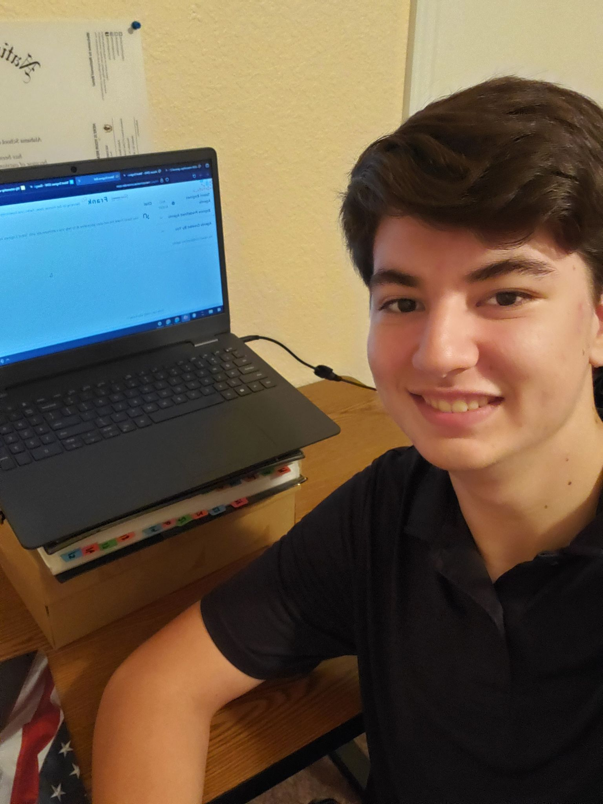
About Me
Going into my senior year at ASCTE in Huntsville
I love archery, piano, reading, video games, camping, fishing, hiking, programming
I plan to attend UAH with a major in computer science
Intern for Talent Engines
Mentored by Abizer Mamnoon

Slide 3
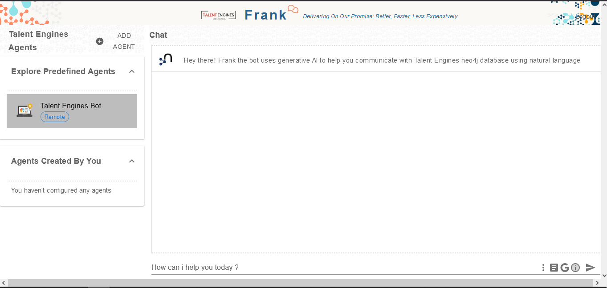
Project overview
Chatbot to generate cypher queries for Neo4j database:
  Researched other tools and solutions to improve our chatbot
  Trained the bot and helped implement google searches into it
Web scraping:
  Reviewed tools for web scraping such as Octoparse and parseHub
  Scraped several websites for information about law firm candidates

Slide 4
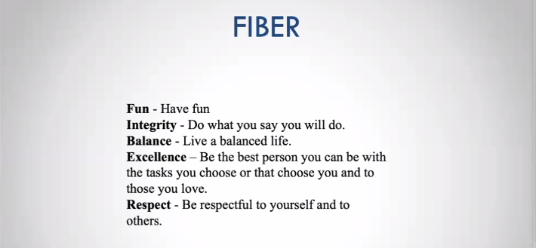
What did I learn?
My confidence in speaking and presenting has grown
I was able to learn valuable lessons in goal setting, personal values, entrepreneurship, and more from the Talent Engines CEO Michael Connolly.
Most of all, I learned perseverance. When times are rough, keep going because there’s always a light at the end of the tunnel.

Slide 5
Conclusion
Working with Talent Engines has been awesome for me this Summer and full of learning experiences. I would like to thank Abizer Mamnoon, Michael Connolly, and Kelsey Bickett for their leadership and support over these past few months. This internship has certainly helped fuel my interest in data science and AI and I look forward to learning more in the future.

