Slide 1
My Internship at Tquila and Quanthub
Alabama Data Scholars Internship Program
Kingston Boatman

Slide 2
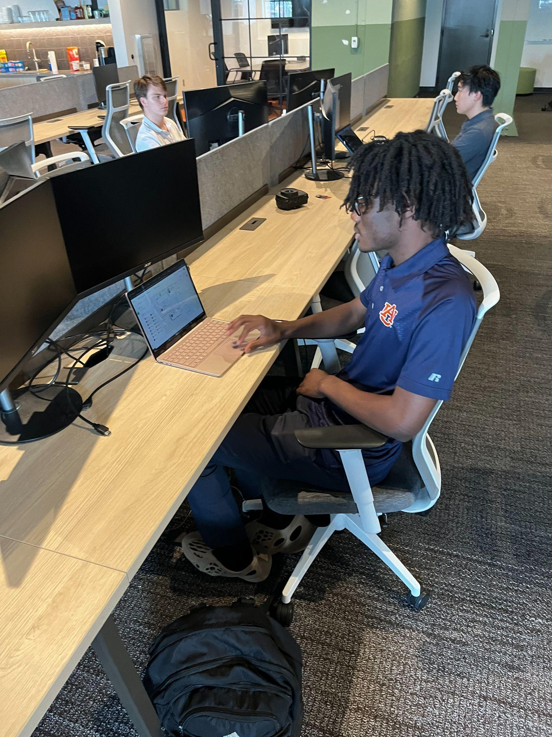
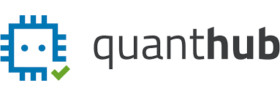
About Me
Upcoming Junior at Hoover High School in Hoover, Alabama
Planning to attend Georgia Tech or Auburn University
Still determining my major in engineering
I enjoy basketball and video games
Data Scholar Intern at Quanthub in Birmingham
Selected by Tquila Automation alongside Preston Gancayco
Mentored by Sophie McAdam and Richard Denton

Slide 3
Tquila Automation
Global automation consultancy that makes robots
Uses other software from partnering companies such as UiPath to create robots
Not the physical robots, but ones in your computer
Creates AI bots that does the boring tasks for humans
Communicates with clients in order to offer the best deal with these bots
Usually a very long process

Slide 4
Tquila Offices
Austin, Texas
Birmingham, Alabama
Bucharest, Romania
Amsterdam, Netherlands
Cardiff, Wales
London, England

Slide 5
Project Overview
Create a recruitment chatbot for hiring managers of the company using Druid Ai and UiPath
Fill in a google form using automation
Responses taken from the user to answer questions

Slide 6
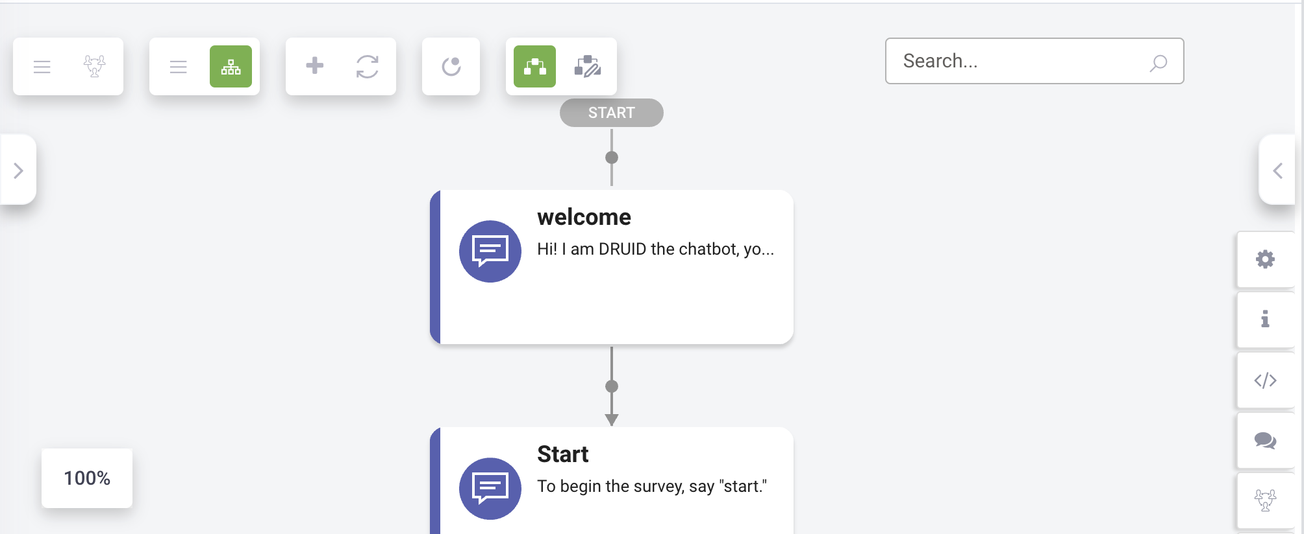
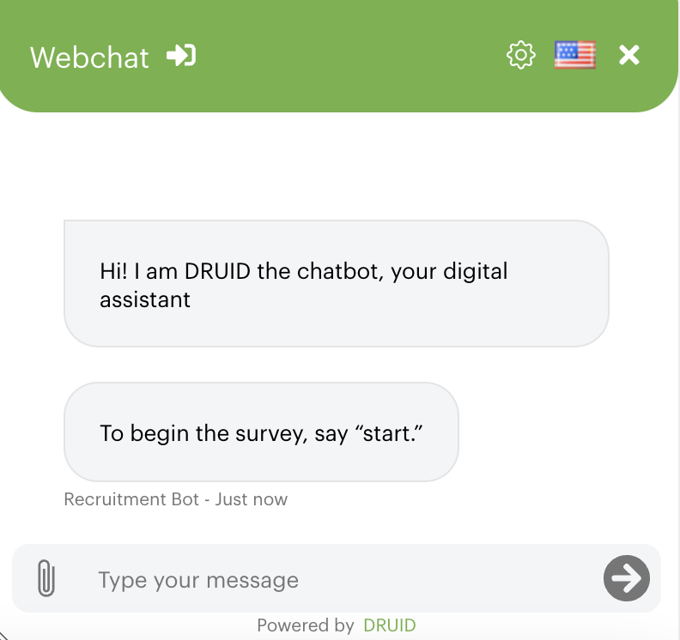
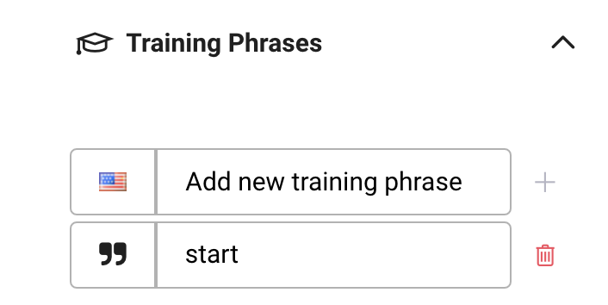
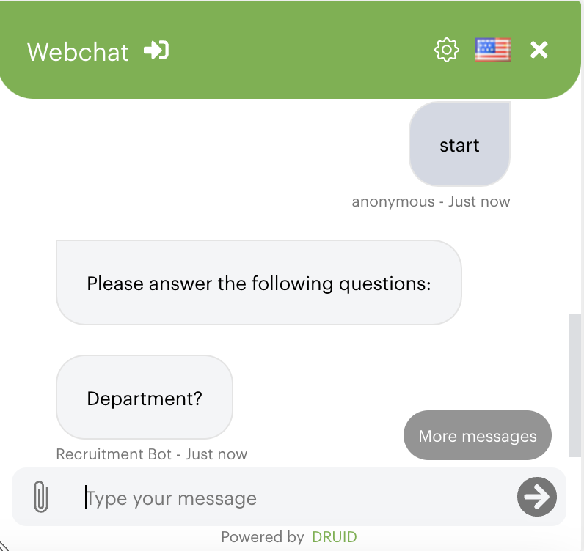
Input
Output
Phrases

Slide 7
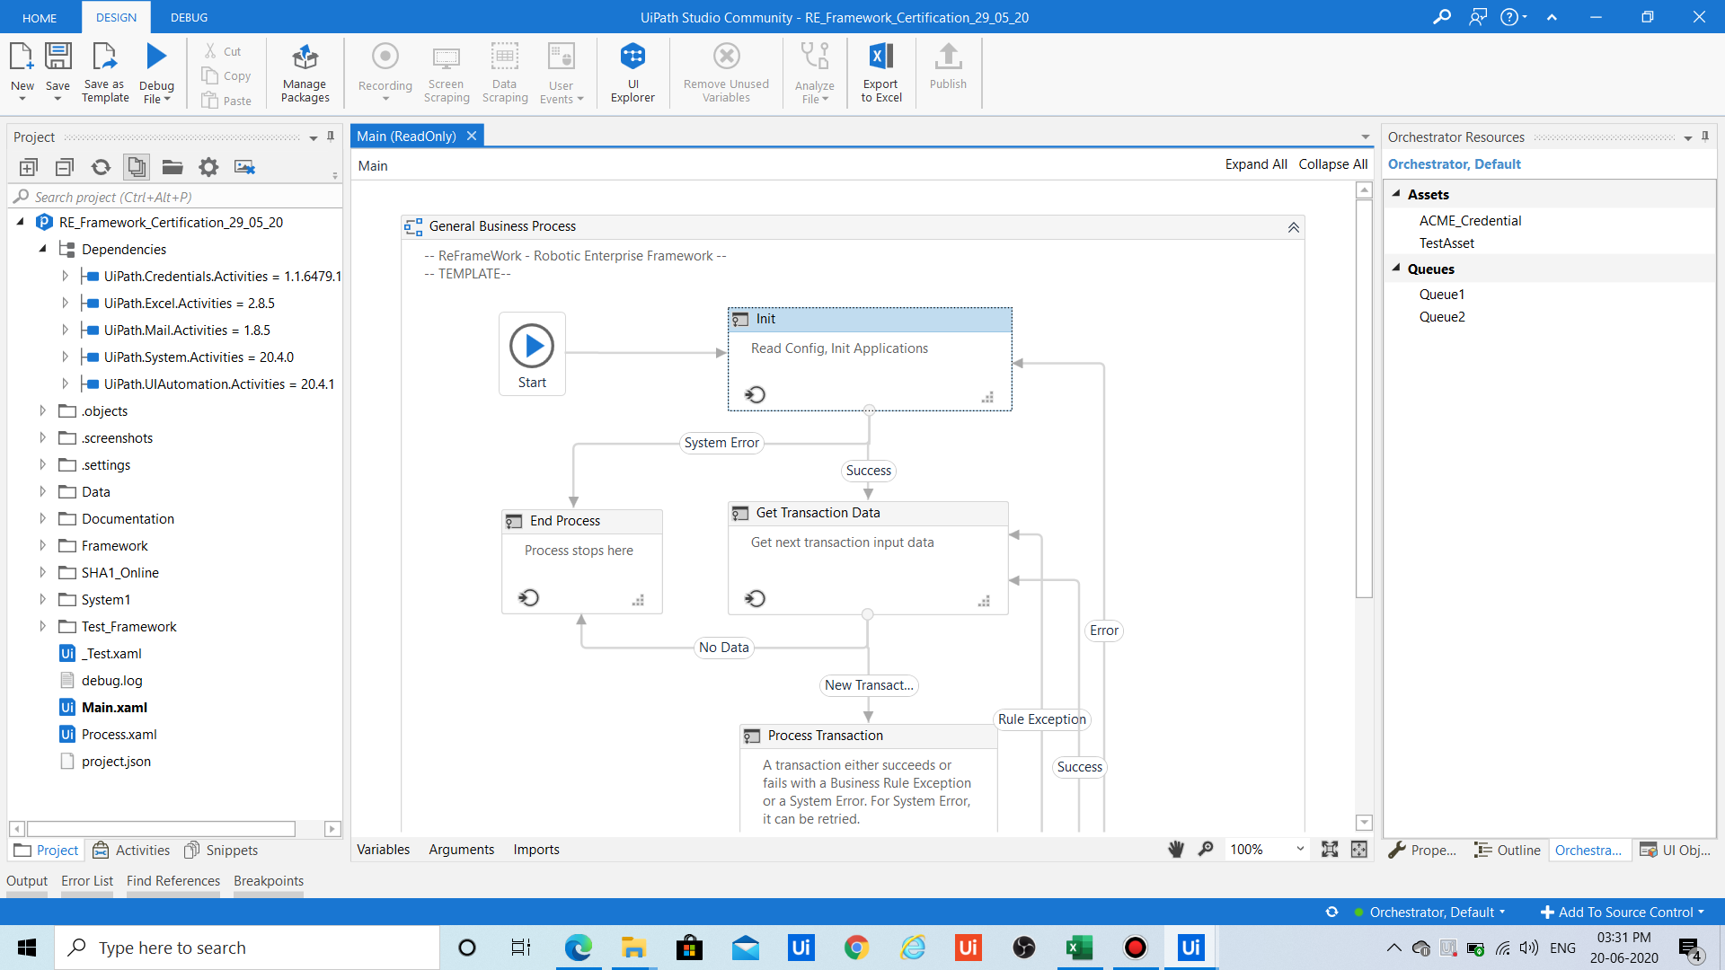
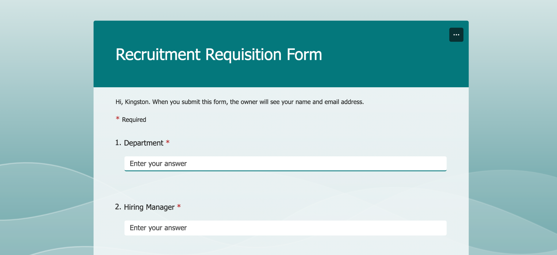
UiPath Automation
Input Into Blanks

Slide 8
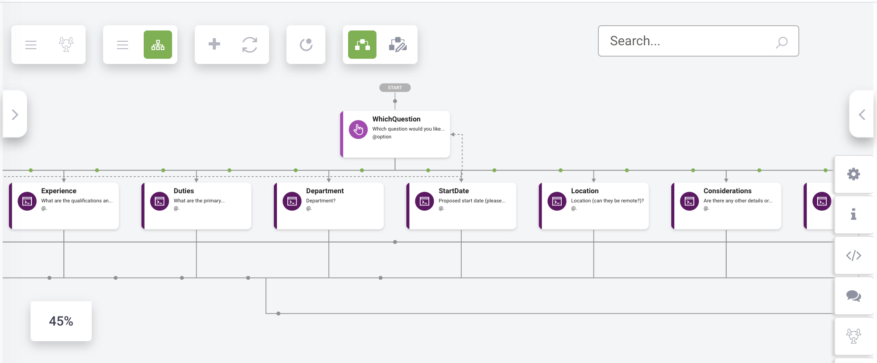
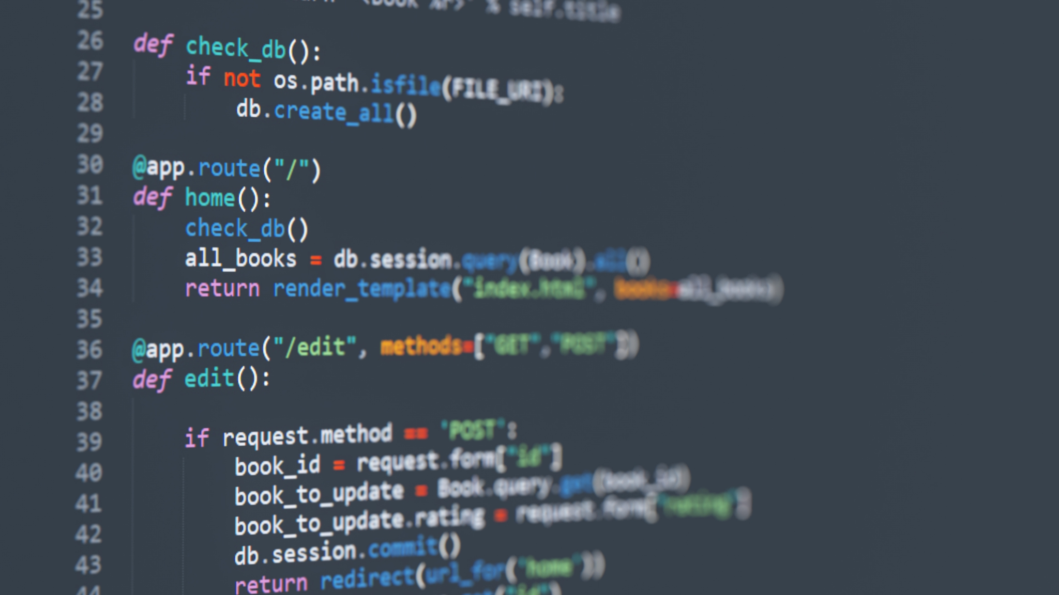
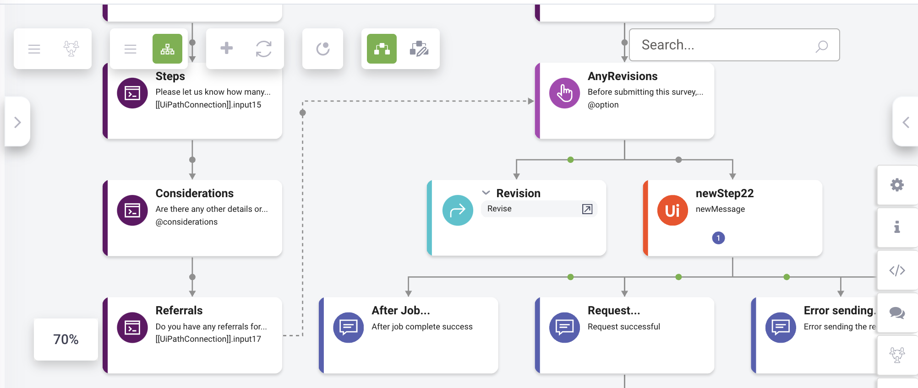
Not at all
Coding Heavy?

Slide 9
What I Learned
Work Experience
Gained valuable experience in working in a office job
Helps narrow down what kind of job I want to work in the future
Data Analytics Experience
Numerous applicable uses
Help narrow down fields I am interested in
College Programs
Became more familiar with different programs that colleges offer
Made me more aware of the possibilities I have access to within Alabama

Slide 10
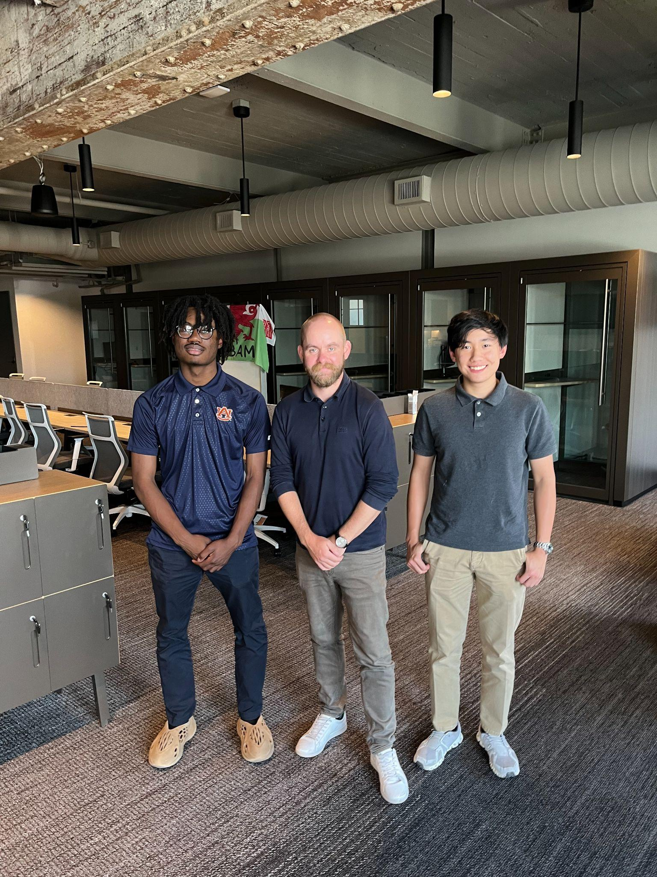
Thank You Staff of Tquila and Quanthub

