Slide 1


My Internship at Ai-Ops
Alabama Data Scholars Internship Program
Sean Davis
July 25, 2024

Slide 2

About Me
Senior at St. Paul’s Episcopal School in Mobile, Alabama
I love computer programming, video games, and running track
Plan to attend college, though not sure which one
  Intend to major in computer science
Data Scholar Intern at Ai-Ops in Mobile
Mentored by Curtis Wright

Slide 3
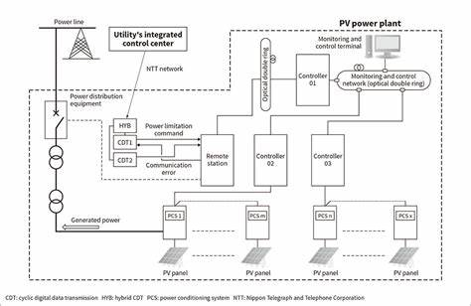
Project Overview
Worked on a paper about how deep-reinforcement learning can be used to improve industry.
My paper focuses on the power plant industry.
DRL is a form of machine learning in which agents take actions to work towards a cumulative reward
I learned how Ai can be used to improve machinery and speed up tedious processes.
Ai can help to regulate turbines and boilers, leading to improved efficiency, reduced maintenance, and minimize fuel consumption.
DRL can lead to significant cost savings over time.
It can power plant industries operate efficiently and competitively
DRL can revolutionize the power plant industry.

Slide 4
Lessons Learned
I learned about deep-reinforcement learning overall.
I learned more about Ai in industry
I feel more confident in speaking to a mentor
It has improved my interest in Ai and computer sciences and I look forward to having a career
Thank you Curtis for this amazing opportunity!

