Slide 1
My Internship at Tquila Automation
Alabama Data Scholars Internship Program
Preston Gancayco
July 25, 2024

Slide 2
About Me
Up coming Senior at The Alabama School of Cyber Technology and Engineering
I love computers, AI, cars, and machine learning
Plan to attend a University after high school
Major: Computer Science and Business Management
Data Scholar Intern at Tquila Automation in Birmingham
Mentored by Richard Denton and the Tquila team

Slide 3
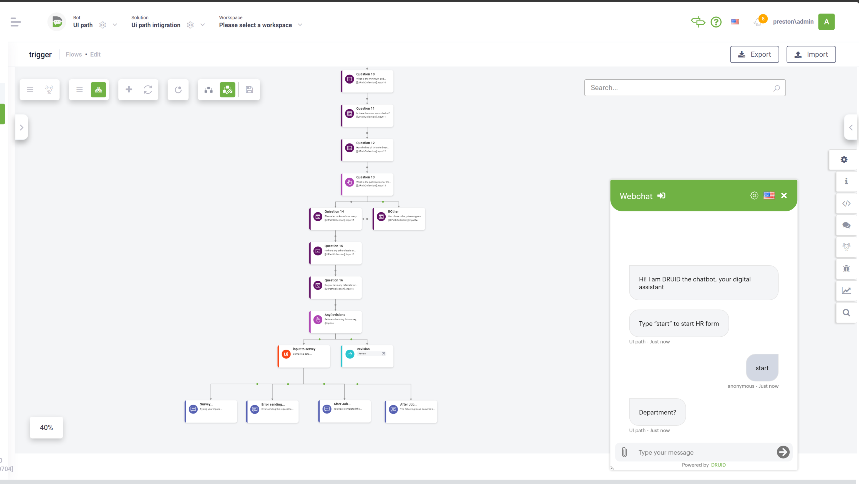
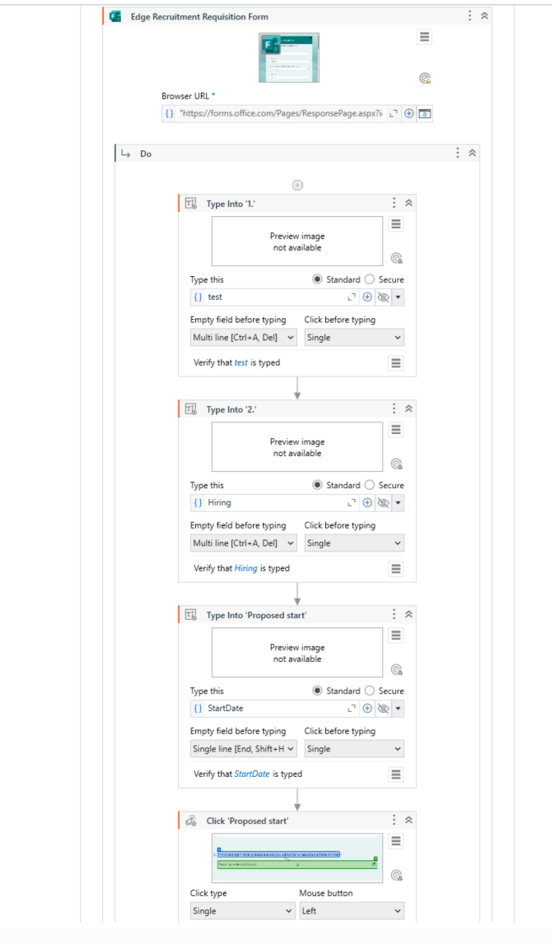
Project Overview
Image of Druid bot
Image of UI path
Made a chatbot for HR to use to streamline the input of new hires to the company.
Used Druid.AI to interact with the user to ask and receive questions and answers
Used UI Path to take the inputs from the Druid bot to type into HR survey

Slide 4
Lessons Learned
I discovered that computer programming and AI was my thing
I got great experience with UI path and Druid.AI
My confidence in collaborating with others has improved
I am interested in exploring entrepreneurship and hope to one day having my own company specializing in tech
Notes:
engoyed the atmosphere of the office at tquila
lastly thank all taquila and quanthub

