Slide 1
July 25, 2024
My Internship at Prosper
Alabama Data Scholars Internship Program
Joely Weaver

Slide 2
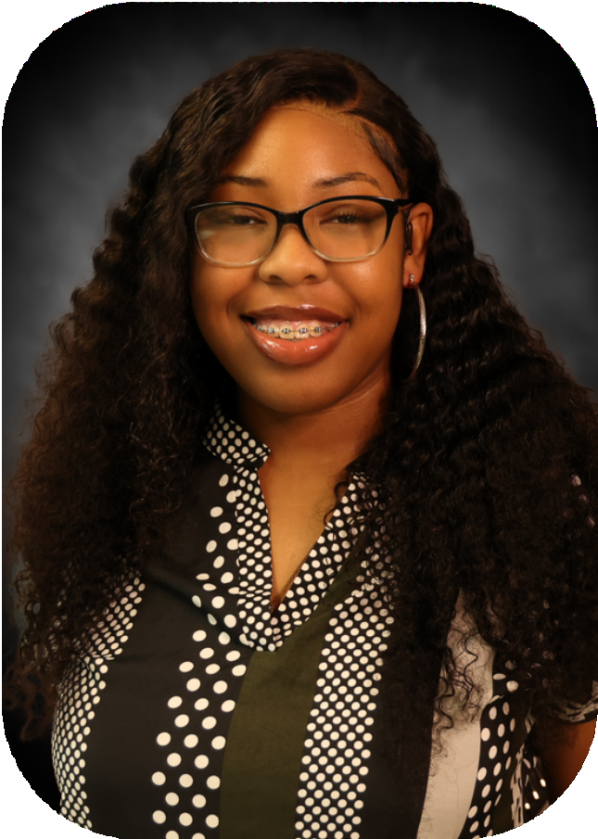
About Me
Started as a senior at Ramsay High in
Birmingham, Al
I love challenges, mystery, and reading Will be attending Wake Forest University Major: Biomedical Engineering and
Anthropology
Data Scholar Intern at Prosper Birmingham Mentored by Aryan Anerao

Slide 3
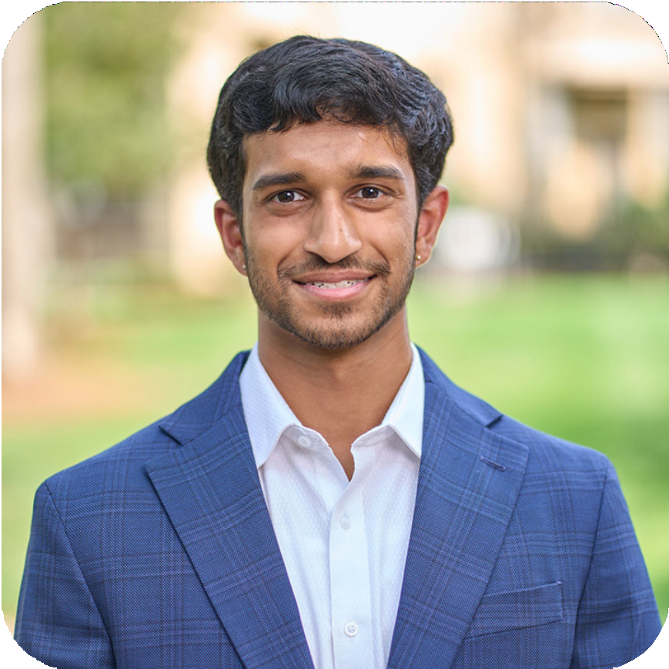
Aryan Anerao
Fun Facts:
Data Specialist
A.K.A The Best Mentor

Slide 4
Project Overview
Objective: Find strategies to diversify the pipeline to C-Suite positions
Focus: Women of Color
Main Objectives and Execution
Methodology:
Conduct interviews with the largest companies in Birmingham
Research diversity strategies of cities outside of Birmingham
Research how to implement found strategies in Birmingham

Slide 5
Potential Strategies

Slide 6
General Strategies:
DEI Council
DEI-Implemented Training
Ongoing Progress:
Track diversity
Outreach
Multigenerational and multilingual offices
Hiring:
Bias Eliminating Software
Remove face and jargon from job
listings
Company Must Haves:
1. Mentorship and Corporate Pathways
Commitment/CEOs:
1. AIRs Certifications
2. Mansfield Certifications

Slide 7
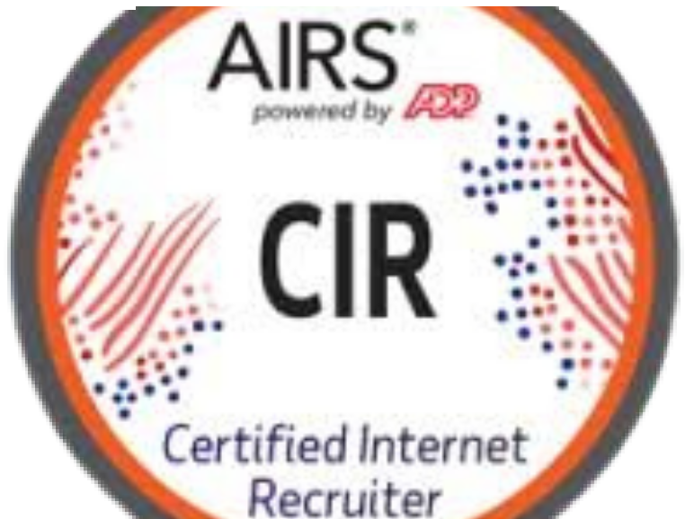

Slide 8
Prosper Potential Strategies
Women’s Leadership Program - CCL
Teamwork
Prosper could create a taskforce to identify social and economic policies that hinder women’s advancement.
Prosper could build and maintain a private metrics dashboard that tracks diversity in leadership.
Prosper can create a cohort- based curriculum for businesses to improve on areas to support women’s advancement.
VISIER

Slide 9
Lessons Learned
I love to do research Networking is crucial
You do not have to be in a office to be productive Learn to come out of your shell and be open

Slide 10
Thank you!
To Quanthub and Prosper Birmingham!

