Slide 1

My Summer at QuantHub
Alabama Data Scholars Internship Program
7/25/24
Joseph Kelly

Slide 2


Internship Overview
During my 8 weeks I was primarily paired with two organizations
  Alabama Department of Commerce RurAL campaign
  Selma & Dallas County economic development Authority
My role involved
  Spreadsheet data management
  Data analysis and reporting

Slide 3
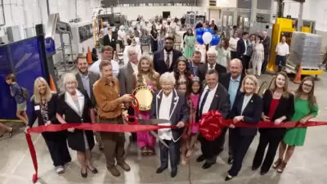
Industry
Event in
Jemison
On June 5, the Alabama Mineral Springs LLC bottling plant had its big opening with Governor Kay Ivey and local officials showing up. The event highlighted how the plant will boost the economy and showed how important it is for the community and government to work together.

Slide 4

Projects & Tasks
Excel Contact Sheets
  Managed & Updated
Grant Info. Spreadsheet
  Researched & compiled
Benefits & Learning Outcomes:
  Technical skills with excel
  Analytical skills in researching &
  compiling data
  Project Management

Slide 5

Coding Skills Developed
Visual Basic Editor:
Learned to create simple macros and debug
SQL:
Learned fundamental of SQL, like querying databases, joining tables, and updating and removing data
Python:
Learned intermediate skills like classes, inheritance, and operator overloading

Slide 6
Future Aspirations
From this 8 week program I have developed a strong interest in Data analytics and Programming
I am committed to ongoing learning and skill development in computer programming and hope to pursue a career in data Science and computer science
Next Steps:
  Pursue higher education in Data Science
  Obtain relevant certifications
  Seek additional intern and work opportunities

Slide 7

Conclusion
Thank you QuantHub, ADC RurAL Division, and the Selma Economic Development Authority for this great internship opportunity
And thank you to Brenda Tuck, Nick Shaver, and Madison Haddock for mentorship and guidance

