Slide 1

My Internship at Simple Helix
Alabama Data Scholars Internship Program
Jonah Mabry
July 25, 2024

Slide 2
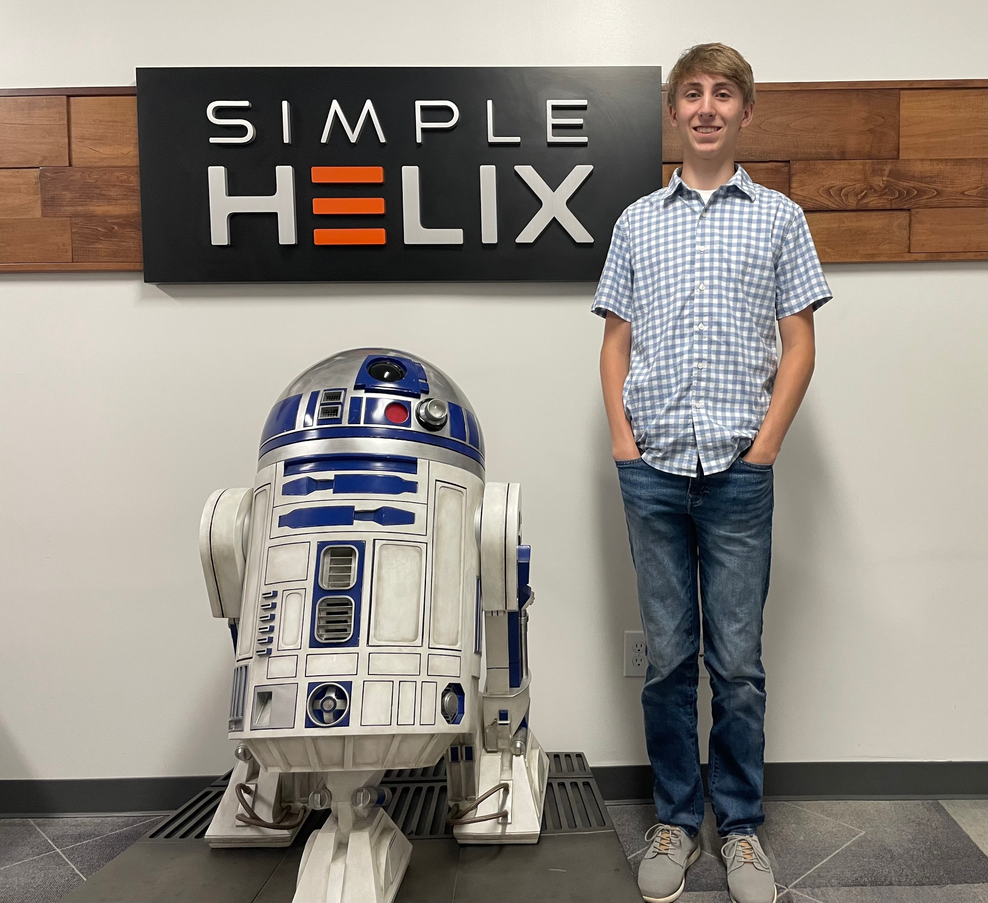
About Me
Rising Senior at Sparkman High School in Harvest, AL
I love to code, play tennis, and play video games
Major: Computer Science or Data Science
Intern at Simple Helix in Huntsville
Mentor: Brad Burns

Slide 3
What I knew prior to the Internship
Not much
Interests:
Python
Machine Learning

Slide 4
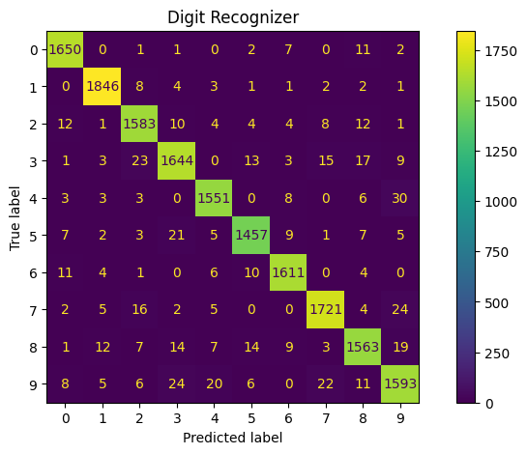
Internship Overview
Learned machine learning on Kaggle.com
  Used various python libraries
  Joined Kaggle competitions
Built a private machine learning training system
  Allows for models to be trained faster using a GPU
Built and trained models on the GPU box
  Classification, Regression, Image Classification, etc.
Predicted Handwritten digits

Slide 5
Projects

Slide 6
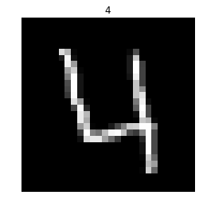
Digit Recognizer
  Type: Image Classification
  Uses handwritten digits
  Accuracy: 96%

Slide 7
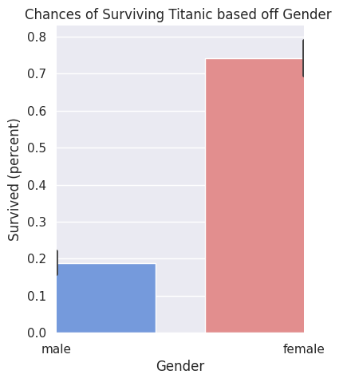
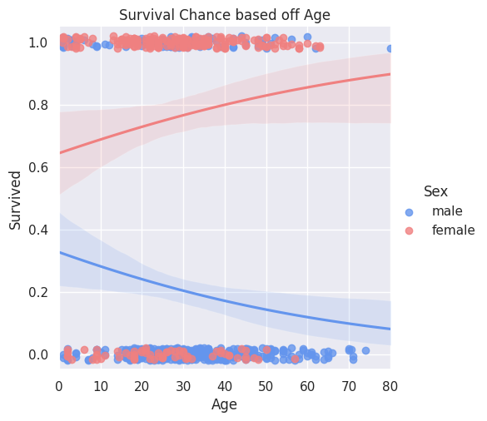
Titanic Survival Analysis
  Shows the different chances of survival based off different factors
  Type: Classification

Slide 8
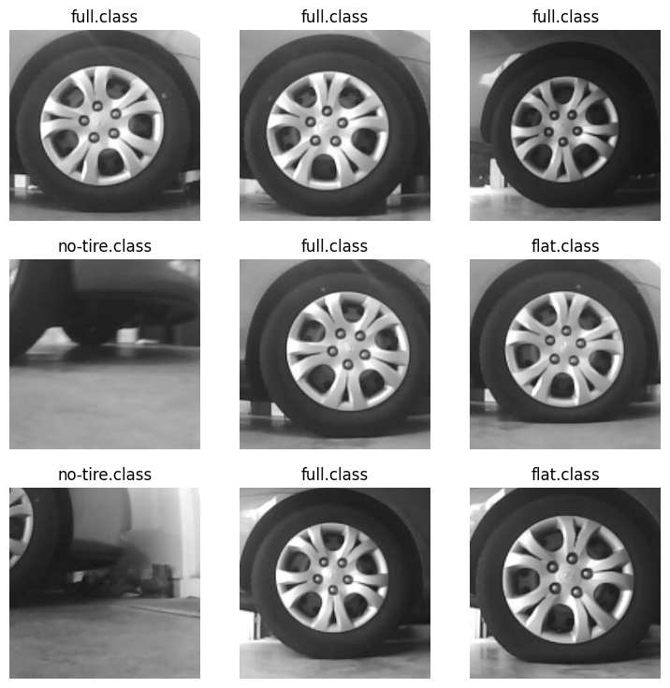
Tire Inspection
  Determine if a tire is either flat, full, or none
  Type: Image Classification
  Accuracy: 98%
Data Sample

Slide 9

Ran models on GPU box
  Run time increased drastically
  Cut training time in half

Slide 10
One problem I faced
My model was doing awesome on the training data, but was doing poorly on the test data.
This is called overfitting
Either my model was too complex, it was training for too long, or there wasn’t enough training data

Slide 11
Ways I tried to fix this
Early stopping
Data Augmentation
Using less layers in my model
Test Accuracy went from 81% to 98%

Slide 12
What I learned
Learned Machine Learning
More Python skills
Neural Networks
Data Visualization

Slide 13
The End

