Slide 1
My Internship
At Reliant Technologies
Through Quanthub’s Alabama Data Scholars program
By Noah Tiffany

Slide 2
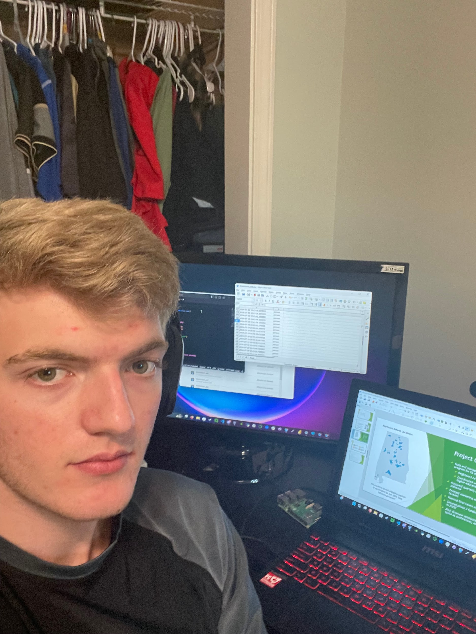
About me
I Graduated from Gulf Shores High School in Alabama
I love learning about computers, playing piano and chess, running, and challenging myself on a new subject.
I plan on attending the University of Alabama at Huntsville
major: computer engineering with a concentration of cybersecurity
I was a Data Scholar intern at Reliant Technologies through Quanthub
I was Mentored by Brett Mcwilliams

Slide 3
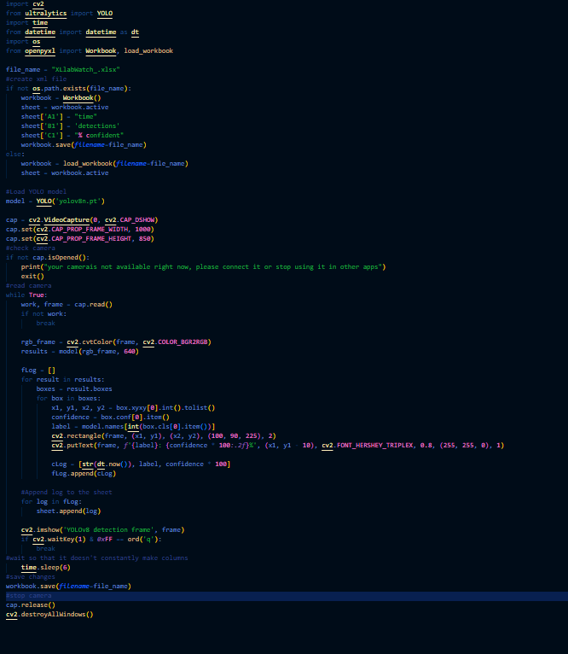
Project overview:
Objective
Create a program that can log when someone enters an area and what they may be doing based on the objects they enter with using OpenCV and the YOLO COCO data set. After the data was recorded, I represented the data on a dashboard in Power BI
Results
I created the program using opencv2 to access my camera, the “YOLOv8” nano version by ultralytics to detect objects, the time module to limit how frequent the program records data, “datetime” module to find the current date and time, the “os” module to create the spreadsheet file and openpyxl to modify the spreadsheet.
The Work behind the scenes

Slide 4
How to create a dashboard with Power Bi
How to find the right AI for specific jobs
Lessons learned
How to manage a database and send commands with SQL (Structured Query Language)
There are plenty of opportunities to learn about and work in in data science

Slide 5
create a program that records visual data
clean and correct errors in the data
02
04
01
03
start collecting data with the program
present the data on a PowerBI dashboard
The Project Process

Slide 6
Key Takeaway
This project doesn’t have to end here: In the future, with a larger storage and a stronger computer, I could create a program that would be used to record the daily habits of an animal; being about to organize the behavior of a monkey, for example, would allow places like a zoo to curate the habitat to the specific animal’s needs because of the different areas that the animal may prefer.

Slide 7
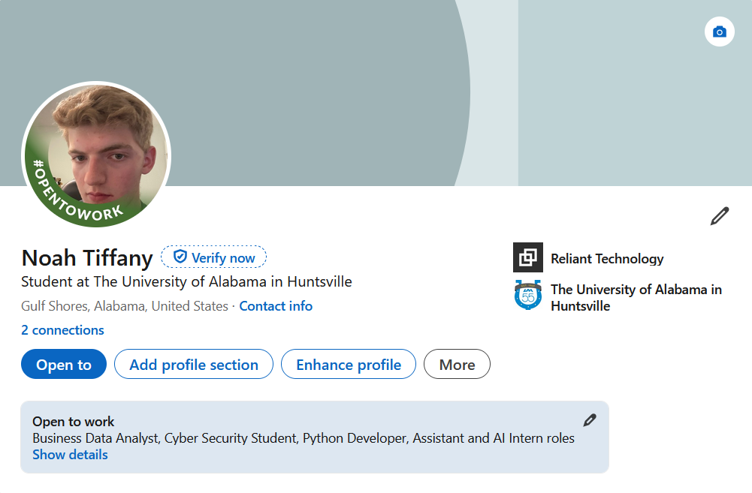
Let’s Connect
THANK YOU
noah.tiffany0530@gmail.com
linkedin: www.linkedin.com/in/noah-tiffany-742435315
Special thanks to Brett Mcwilliam for helping me with this project

