Slide 1
Internship of AI-Aided Drug Discovery through QuantHub
Makayla Woods | July 25, 2024
Scientific Platforms, Southern Research
https://southernresearch.org/services/artificial-intelligence-computer-aided-drug-design/

Slide 2
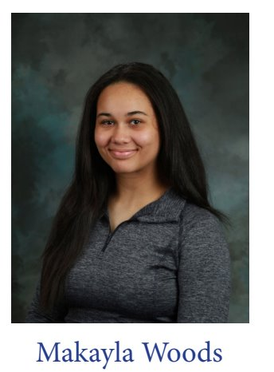
About Me !
I am an upcoming senior at the Alabama School of Mathematics and Science ​
In my free time I like reading and playing the piano​
I plan on attending the University of Alabama at Birmingham ​
Majoring in Biomedical Sciences​
Minoring in Computer Science​
Data Scholar intern at Southern Research Institute in Birmingham ​
I was mentored by Zachary Brooks and Sixue Zhang ​
​

Slide 3
Internship Experience
Tour of the Integrated AI Drug Discovery Platform at Southern Research Institute
Participation in the data analysis for an AI drug discovery project
Tutorial of cloud-based cheminformatics platform Optibrium StarDrop
Tutorial of NVIDIA’s cloud-based generative AI platform
Summary

Slide 4
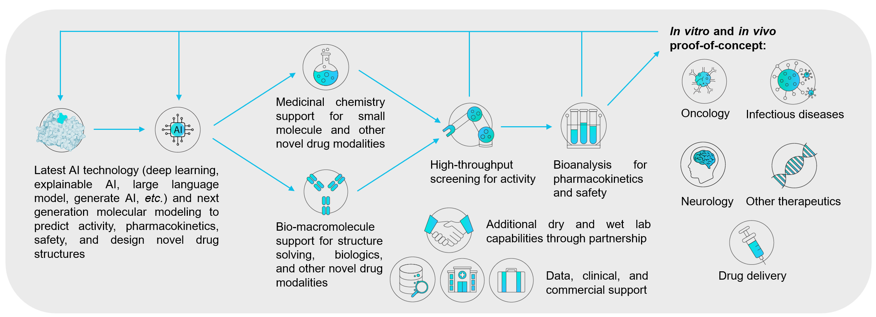
Tour of Integrated AI Drug Discovery Platform
Southern Research’s integrated Design-Make-Test-Analyze platform for AI drug discovery supports therapeutic target discovery all the way to clinical candidates.
Tour of the dry lab (AI lab) as well as wet labs (e.g., robotic platform in the high throughput screening center) were given.

Slide 5
Participation in the Data Analysis for AI Drug Discovery
In this project, we aim at developing an AI-enhanced reverse docking algorithm to help predict drug safety.
List of protein targets (e.g., druggable GPCRs, kinases) often concerned as liability for drug safety has been curated from multiple online databases.
Next step would be to incorporate the above list into the reverse docking algorithm under development.

Slide 6
Tutorial of Cheminformatics Platform Optibrium StarDrop
Optibrium StarDrop is a cloud-based cheminformatics platform used to predict pharmacokinetics and toxicology properties to aid the design of orally available and safe drug candidates.
Tutorial of how to use StarDrop such as prediction of metabolic stability and cardiotoxicity of drug candidates was given.

Slide 7
Tutorial of Cheminformatics Platform Optibrium StarDrop
Besides in-house developed AI models, we also leverage the generative AI on NVIDIA cloud computing platform.
Tutorial of the use of NVIDIA BioNeMo to generate novel analogs of a given chemical scaffold was given.

Slide 8
Summary
I Gained the landscape picture of the overall drug discovery pipeline
I Obtained first-hand experience in AI drug discovery
I Learned relevant knowledge of chemistry, biology, and data science for the interdisciplinary field of AI aided drug discovery

Slide 9
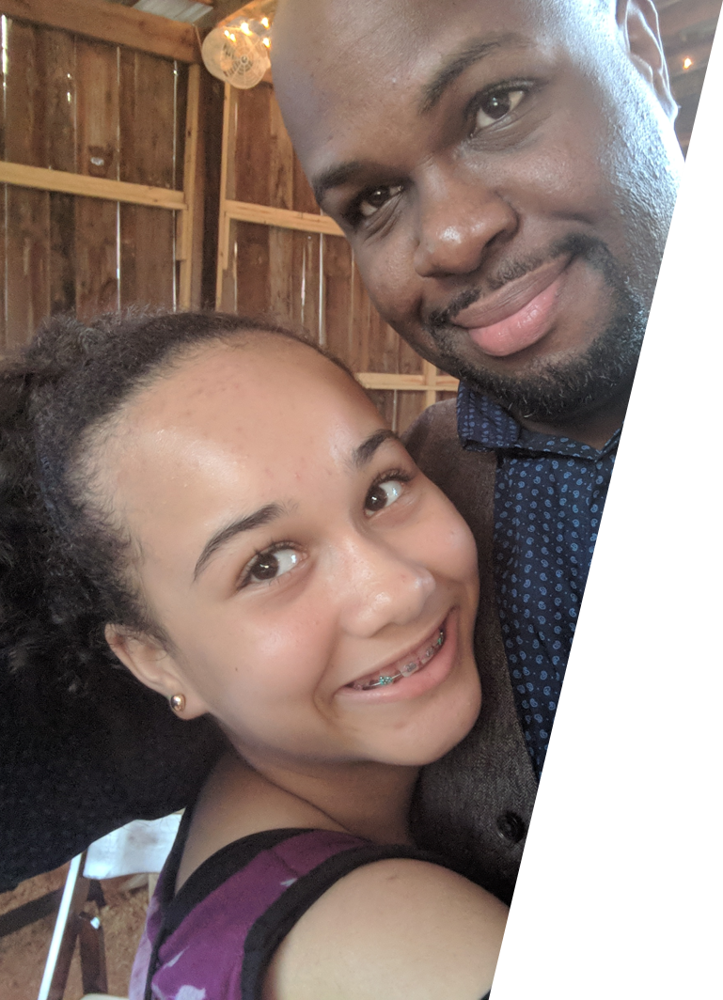
A little Backstory
My dad is my best friend - and my twin! ​
He taught me from a young age how to code - python, c# etc. ​
He had an internship with Southern Research when he was younger – in the engineering program ​
He still inspires me to this day to be the very best I can be! ​

Slide 10
Thank You!
Southern Research Personnel:
Nusrat Jahan
Sixue Zhang
AJ Reese
Paige Vinson
Rebecca Boohaker
Omar Moukha-Chafiq
Corinne Augelli-Szafran
Zachary Brooks
Josh Carpenter
Special thanks to the following organizations:
Southern Research
QuantHub – Kelsey Bickett
Innovate Alabama

