Slide 1
Rishi
Yellamraju
07
25
2024
QuantHub.
Alabama Data Scholars Internship Program

Slide 2
table of contents
about me
project overview
final products
skills gained

Slide 3
about me
Graduated from the Alabama School of Fine Arts in Birmingham
Attending the University of Pennsylvania
Majoring in Computer Science
Data Scholar Intern at Southern Company
Mentored by Seth Brown
Worked on-site at the Alabama Power Headquarters in Birmingham

Slide 4
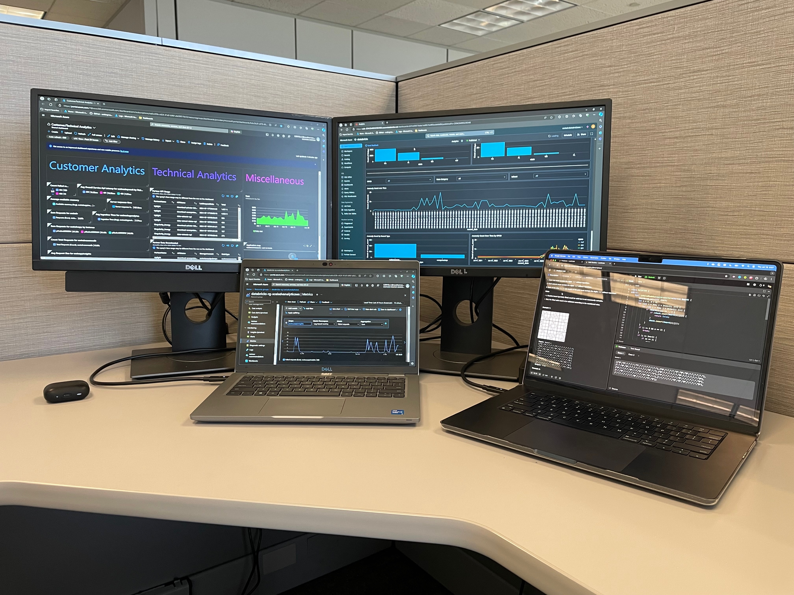

Slide 5
project overview
what is EIX?
Energy Information eXchange (EIX) is a data sharing tool utilized by the electric operating companies of Southern Company to share energy, billing, and customer data with key customers and third-party vendors.
EIX is built in Microsoft Azure and has external APIs available for these partners to integrate with to receive daily data files.
what is our solution?
Primary goal
Develop a dashboard within Microsoft Azure that would allow the team to better identify issues as they happen and more quickly respond.
The dashboard should include details on both API health and infrastructure information.
Secondary goal
Develop a dashboard within Databricks to support the team’s data anomaly tracking work.
Each day, potentially millions of data points are uploaded to EIX’s Databricks warehouse, so it is important to leverage data techniques to identify any anomalies in the data.
what is the problem?
Currently, the team supporting EIX has a need for better visibility into API health, API log details, and API infrastructure information.
The team must currently spend time digging into logs and developing custom queries whenever issues or questions arise about API usage.
This approach is often reactive to issues, rather than proactively identifying potential problems or risks.

Slide 6
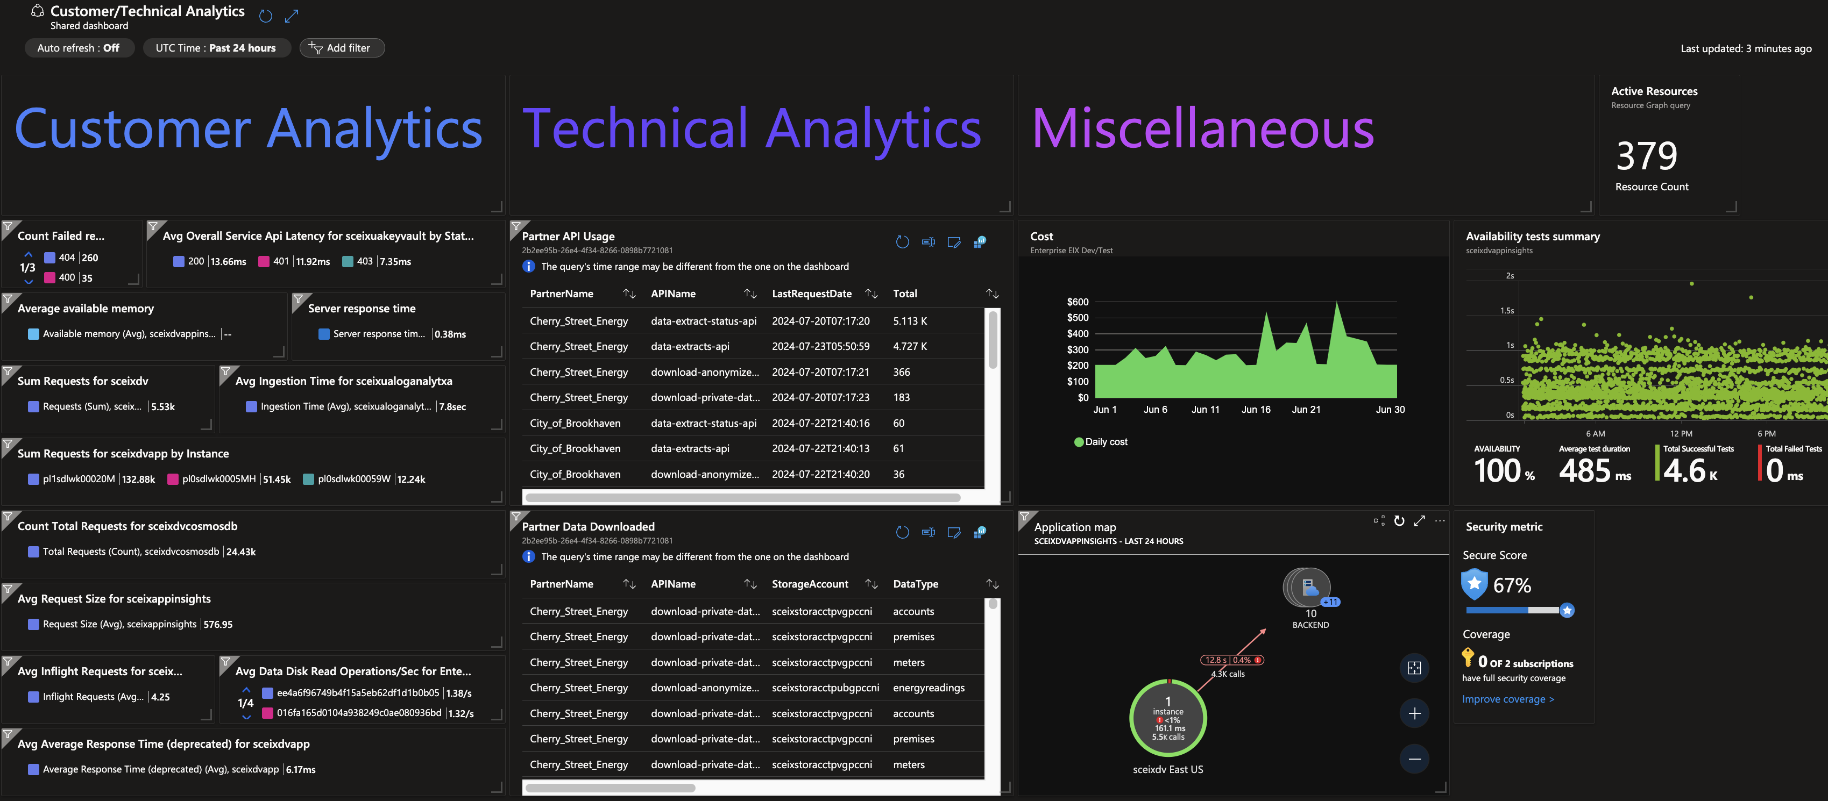
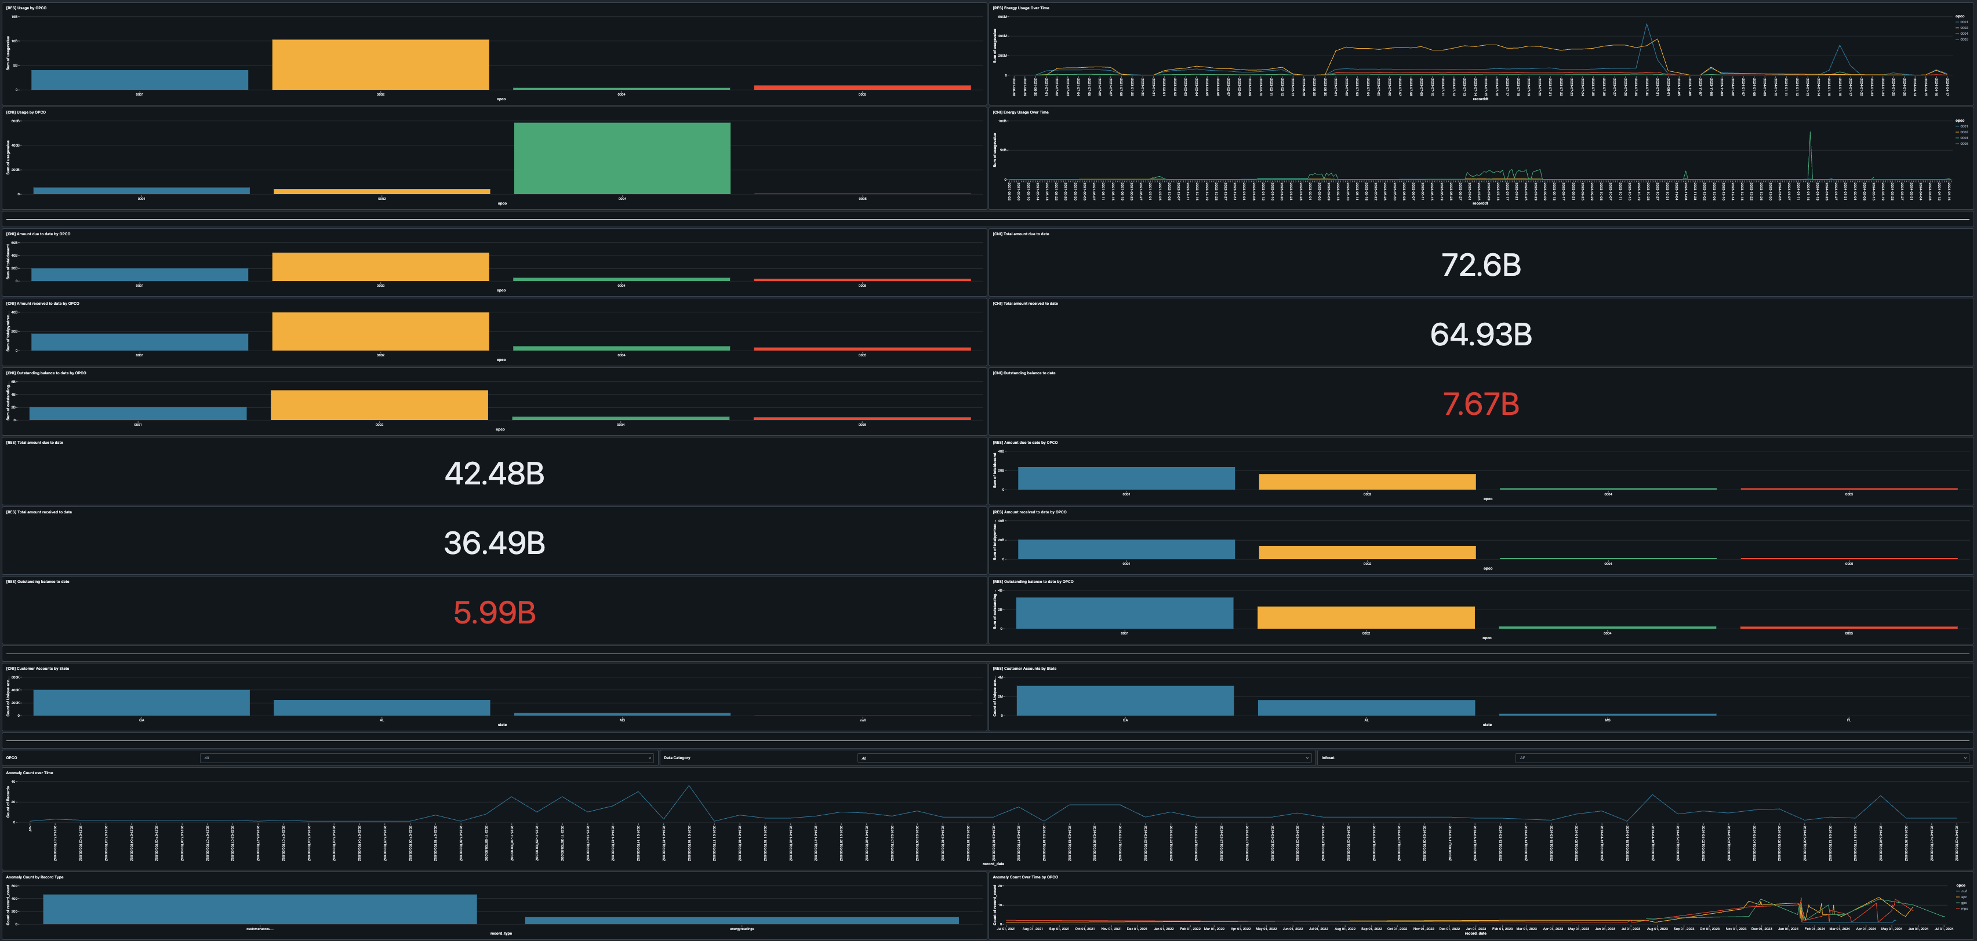
Azure Dashboard
Databricks Dashboard
This dashboard reports on various
customer analytics
failed requests
server response time
API latency, etc.
technical analytics
partner API usage
partner data downloaded
miscellaneous metrics
Azure’s total cost of ownership (TCO)
summary of availability tests
This dashboard reports on various
energy usage metrics
energy usage over time by operating companies
customer billing data
total amount due to date
total amount received to date, etc.
account metrics
number of customer accounts by state
data anomaly counts

Slide 9
SQL
Data Visualization
Microsoft Azure
Gained experience using SQL with real data.
Wrote queries for dynamic data visualization elements in dashboards.
Worked to conveniently display relevant information from large datasets.
Passed the AZ-900 Certification Exam.
Gained experience working with Azure to build dashboards and manage enterprise databases.
skills
gained
API Management
Databricks
Learned conceptually about the usage of APIs.
Gained experience working with an industry-level implementation of an API.
Gained experience working with Databricks to build dashboards.

Slide 10
acknowledgements
Thank you, Kelsey and QuantHub, for this amazing opportunity!
Thanks to Seth Brown as well for the mentorship!

